Slide 1

Computer Science
Introduction to Leaving Cert Computer Science
- Ms Smyth

Slide 2
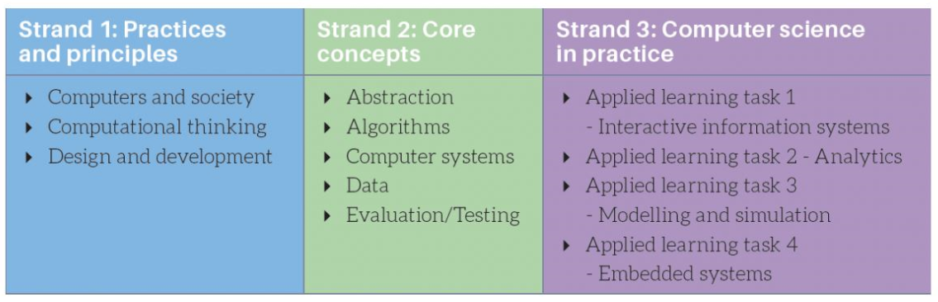
The 3 parts to Leaving Cert Computer Science

Slide 3
Computer Science Learning Outcomes
Strand 1:
  23 learnings Outcomes in Strand 1 (Practices and Principles)
    1.1 describe a systematic process for solving problems and making decisions
    1.2 explain how the power of computing enables different solutions to difficult problems
    ………
Strand 2:
  22 learnings Outcomes in Strand 2 (Core Concepts)
    2.1 use abstraction to describe systems and to explain the relationship between wholes and parts
    use a range of methods for identifying patterns and abstract common features

Slide 4
What will I study in computer science
Learn to program in Python, HTML, CSS, JavaScript
Use a Micro:Bit – embedded systems
Data Analytics & Modelling
A History of Computer Science
Computer System (Hardware & Software)
Computational Thinking
The development of software
Databases

Slide 5
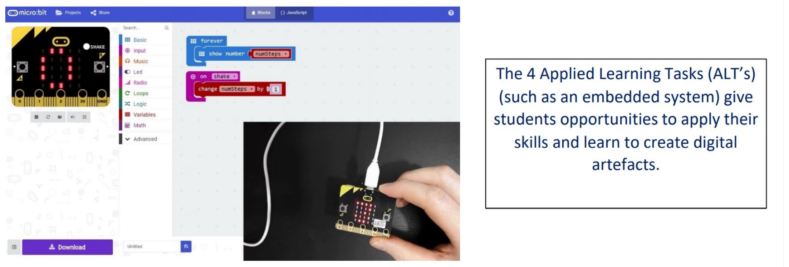
Strand 3 - Applied Learning Tasks ?
Strand 3: Has 14 Learning Outcomes

Slide 6
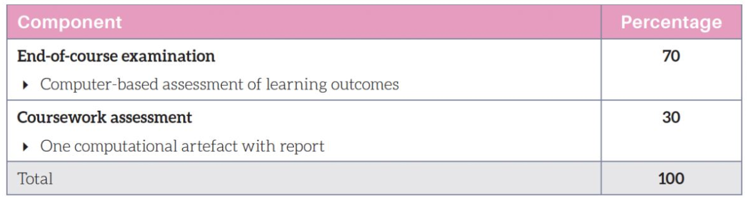
How am I assessed in Leaving Cert Computer Science?

Slide 7
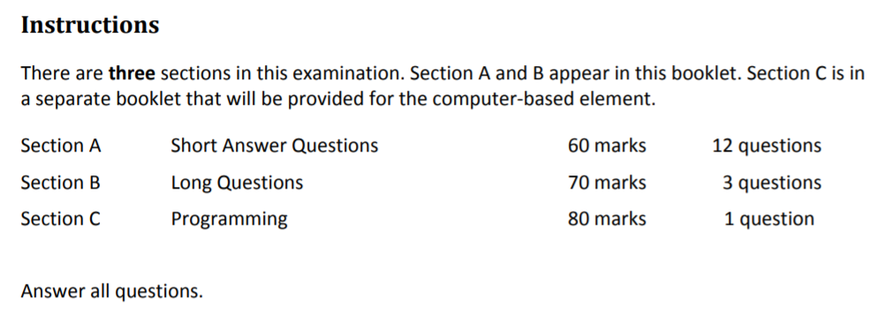
The Actual Leaving Certificate Exam – takes place in Late May

